Slide 1
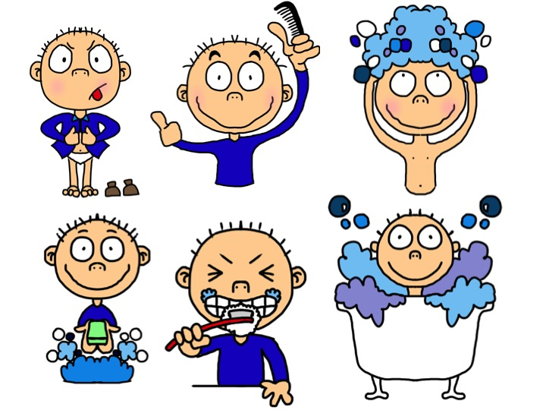
Taking Good Care of Ourselves: Personal Hygiene

Slide 2
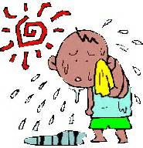
Sweating It Out
Sweating has an important job – it helps
to cool your body down when you are hot.
You actually have two to four million
sweat glands all over the body.
But thanks to puberty, these glands not
only become more active than before they also begin to secrete different chemicals into the sweat that has a strong smelling odor
How do you know if you have
unpleasant body odor?
1) Strange as it may seem,
people with unpleasant body
odor are unable to smell their
body odor.
2) You may have an unpleasant
smell if you do not shower or
bathe at least once a day.
3) If you do not change clothes
and undergarments daily.
4) Air out shoes and socks to
avoid stinky feet.
Don’t panic, Sweat and smell are normal
parts of becoming an adult.

Slide 3
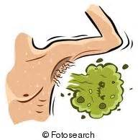
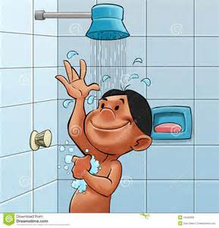
Getting Rid of the Smell
Shower or take a bath every day.
Wearing clean clothes, socks, and underwear each day can also help you to feel clean.
If you sweat a lot, find clothes made from
cotton or other natural materials will help
absorb sweat more effectively
If you're concerned about the way your
underarms smell, you can try using a deodorant or deodorant with antiperspirant.
Deodorants get rid of the odor of sweat by
covering it up
antiperspirants actually stop or dry up
perspiration.
Remember: nothing smells better than clean skin. Perfumes are not a good substitute for a shower or wash.

Slide 4
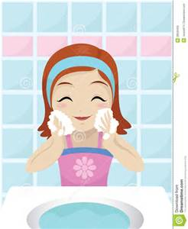
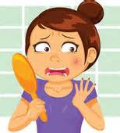
Scoop on Skin Care
The best way to take care of your face is to keep it clean by washing your face twice a day with mild soap
Acne often starts in your early teen years because your body is making more oil glands.
A few different skin problems are a part of acne:
Whiteheads: hair follicle (root) is
plugged with oil and skin cells
Blackheads: plugged up stuff comes
up to the surface of the skin and the air
touches it
Cystic acne: plugged follicle breaks deep
Inside in the skin, nodules or cysts form
What can make acne worse?
Oil-based make-up, suntan oil, hair gels, and sprays
Stress
Your period
Picking at your pimples
Scrubbing your skin too hard
Getting too much sun

Slide 5
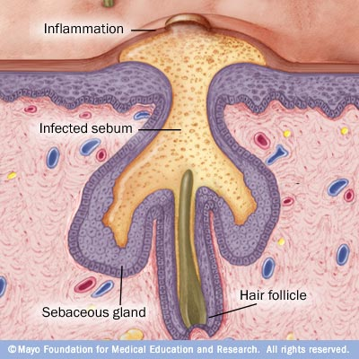
How acne develops
Four main factors cause acne:
Oil production
Dead skin cells
Clogged pores
Bacteria
Acne develops when sebum — an oily substance that lubricates your hair and skin — and dead skin cells plug hair follicles. Bacteria can trigger inflammation and infection resulting in more severe acne.

Slide 6
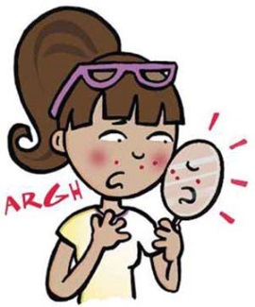
Myths About Acne
Myth #1: Tanning clears up skin.
Although a tan may temporarily
mask acne, the sun can make the
skin dry and irritated, leading to
more breakouts in the future
Myth #2: Chocolate and greasy
foods cause acne
Although eating too many sugary,
high-fat foods is never a good
idea, studies show that
NO SPECIFIC FOODS have been proven to cause acne.
Myth #3: The more you wash your
face, the fewer breakouts you'll have As a general rule, wash your face twice a day with mild soap and water in a circular motion and gently pat dry when you're done.
Myth #4: Popping pimples will help
them go away faster
By squeezing pimples and zits, you can actually push bacteria, dead skin cells, and oil further into the skin.
Myth #5: Don't wear makeup if you
want clear skin
As long as you choose cosmetics that are doesn't block pores, it’s ok.
Myth #6: If you keep getting breakouts,
it helps to use more acne medication until the breakouts stop.
Because acne medication contains drying agents like benzoyl peroxide and salicylic acid, using too much medication may cause
overdrying.

Slide 7
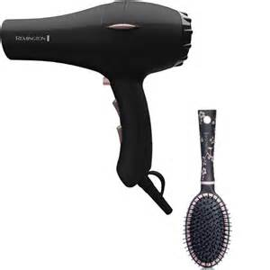
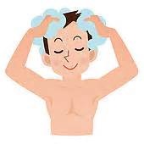
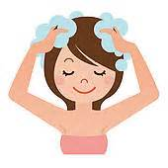
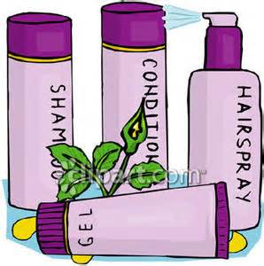
Get Healthy, Gorgeous Hair
The same kind of oil that causes breakouts on
your face also comes out of the pores on your scalp. Each strand of hair has its own sebaceous (oil) gland. As you approach/enter your teens, the sebaceous glands produce extra oil. It can make your hair look too shiny, oily, and greasy.
If your hair is oily, wash it every day.
Wash regularly with shampoo (cheap ones are often as good as very expensive ones).
Massage your scalp well. This will remove dead skin cells, excess oil and dirt.
Rinse well with clear water.
When you're styling your hair, pay close attention to the products you use.

Slide 8
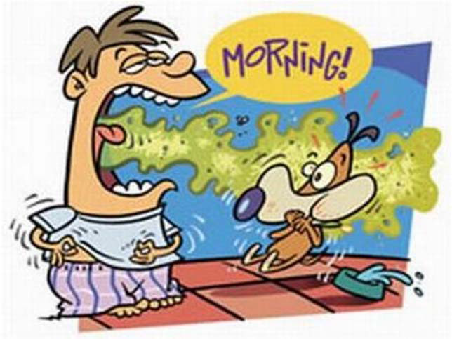
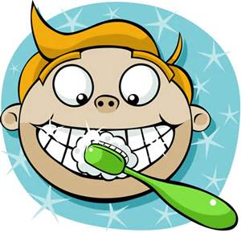
Smelly, Baaad Breath
Bad breath, also called halitosis, is caused by bacteria that grow in your mouth.
The bacteria gather on the small food pieces left in your mouth, especially between your teeth.
Tips for preventing bad breath:
Brush your teeth (and tongue!) for at least 2 minutes twice a day with a fluoride toothpaste, especially after meals.
Floss every day.
Replace your toothbrush every 3 to 4 months.
Avoiding certain foods: garlic, onion, cabbage, coffee.
Visit your dentist every 6 months.
A neat trick that can reduce bad breath is to brush your tongue.

Slide 9
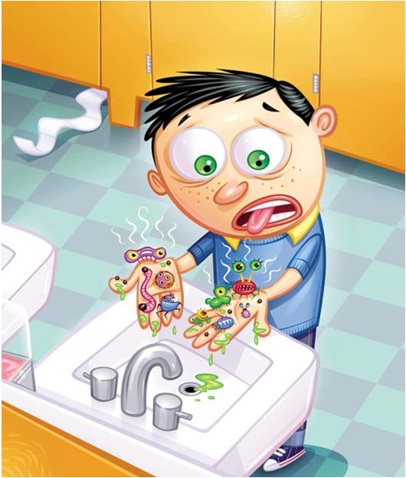
Clean Hands, Please!
The single most important thing we can do to keep from getting sick and spreading illness to others is to clean our hands!
Hands are the easiest transporters of germs and bacteria.
Let’s Get it Right!
1. Wash your hands with warm water and soap for at least 20 seconds. (Happy Birthday song TWICE).
2. You may need a brush to get under nails if they are dirty.
3. Use something clean to dry your hands, such as paper towel or a hot air dryer.
Hand Sanitizers – Great Way to Decontaminate Hands
Use when no access to sink
Reduce bacteria counts
Kills microorganisms
Quick and easy
You should wash your hands thoroughly, especially after using the restroom, coughing, sneezing, touching animals and before handling food.

Slide 10
Let’s Recap
Shower or take a bath every day.
Wash your face regularly to help prevent or worsen acne.
Use a deodorant (covers smell) or an antiperspirant (decreases sweating),
or a product that has both.
Brush your teeth (and tongue!) for at least 2 minutes twice a day with a fluoride toothpaste, especially after meals.
Change your clothes and undergarments daily.
Wash your hands with soap and warm water for 20 seconds (sing happy birthday song twice) frequently.

